Slide 1
- Getting started - Purchase
Tryton By Example
Github - https://github.com/clixwise/tryton-by-example Version of presentation : 6.0 Version of Tryton : 6.0 Verified for execution on : Windows 10 & Powershell 7 Licence : CC BY 4.0 Author : Marc Rottiers

Slide 2
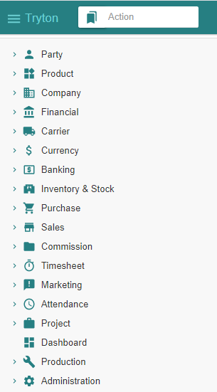
Table of Contents

Slide 3
TOC
MODULE ACTIVATION
Supplier
Product
Inventory & Stock
Purchase
STATE CHANGES
State Change Template
PURCHASE PROCESS
Supplier Purchase
Supplier Shipment
Supplier Invoice
Supplier Payment
Activating Supplier-related modules
Activating Product-related modules
Activating Stock-related modules
Activating Purchase-related modules
The entities that record changes when performing “Purchase” related operations
Recording a Purchase
Recording a Shipment
Emitting an Invoice
Paying an Invoice

Slide 4
Supplier

Slide 5
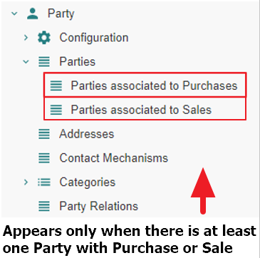
Motivation
Suppliers are named « Parties associated to Purchases ». We name them hereafter « Supplier » for commodity.
Suppliers are in fact party entity roles : any party promotes to a supplier as soon as one or more purchases are linked to it. Same for sales.
Creation : a supplier can be defined by creating an instance with the Menu Tree Item
« Parties » or
« Parties associated to Purchases » if it exists (see Access hereafter).
Access : as long as no purchase is linked to a party, it is not recognized as a supplier and will only be accessible using the Menu Tree Item « Parties ».
Note finally that « Party » modules have been activated as explained in the previous document « Basic Functionality ».

Slide 6
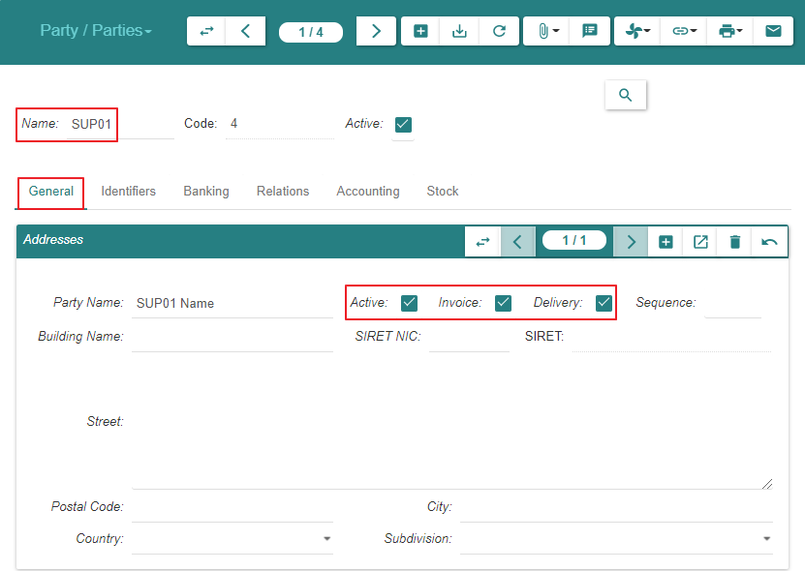
Create

Slide 7
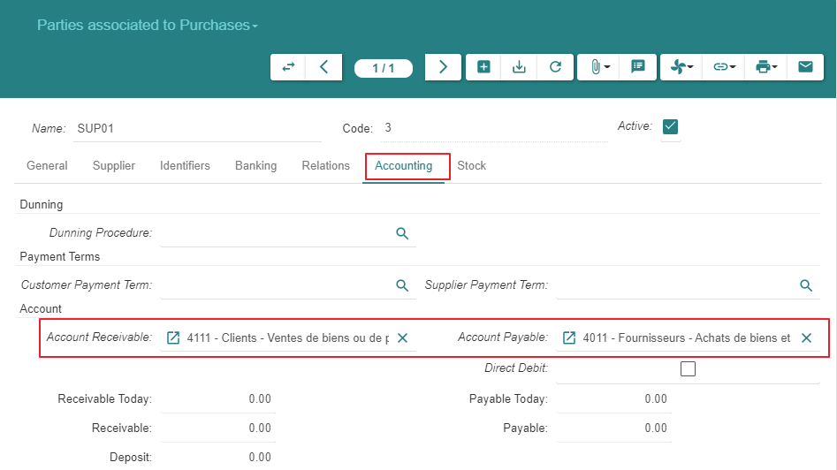
Create

Slide 8
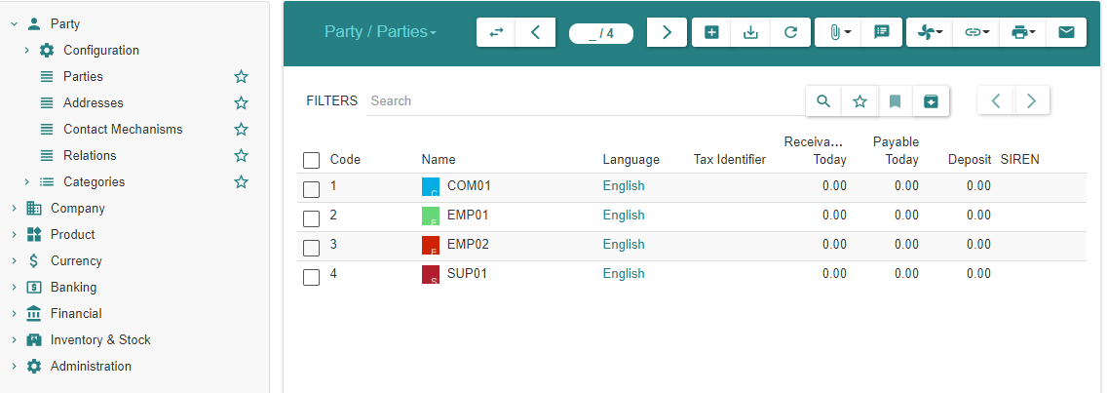
Summary
As explained under « Motivation », the supplier always appears in the list « Parties » above
As long as there are no purchases linked to the supplier, it is absent from « Parties associated to Purchases »
When at least one purchase exists, the supplier appears in both lists

Slide 9
Product - 1/2

Slide 10
Motivation
We activate all inactive « Product » related modules
We define a « Product » and its « Variant »

Slide 11
Module Activation

Slide 12
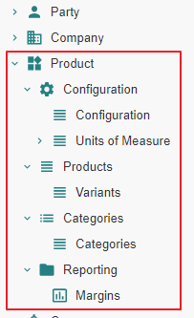
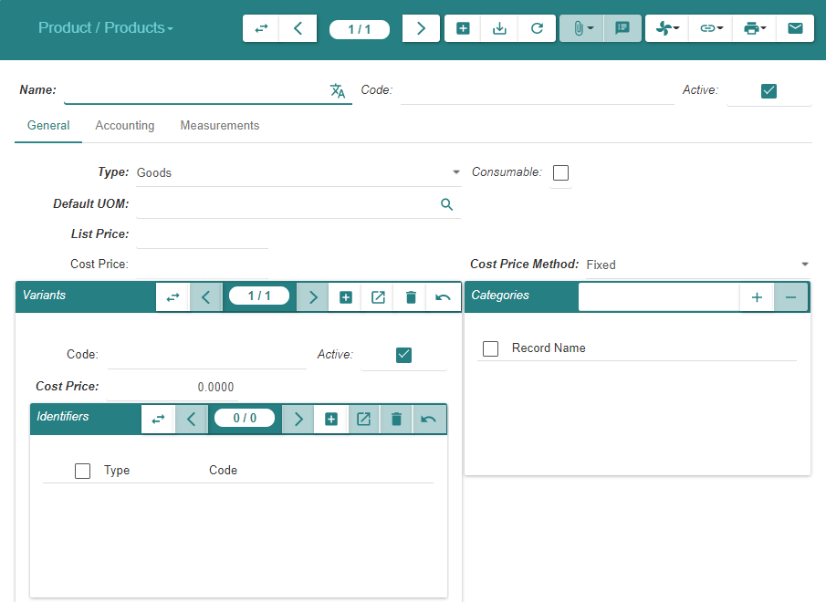
State « Ante »

Slide 13
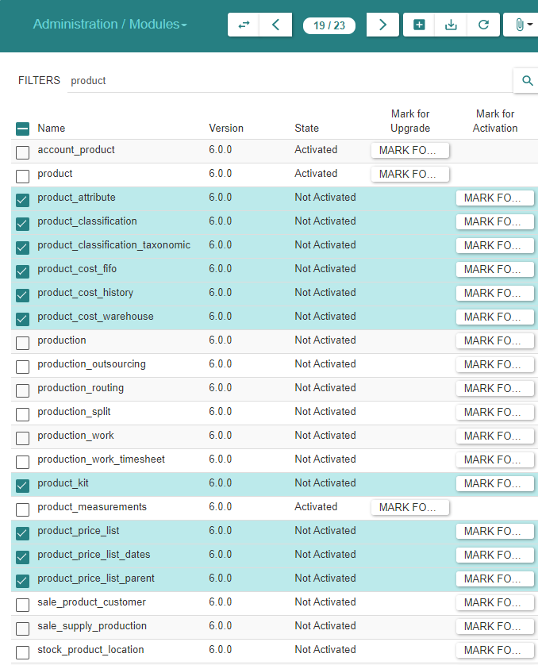
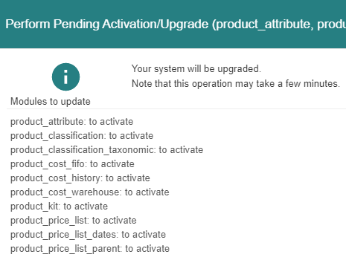
Module Activation

Slide 14
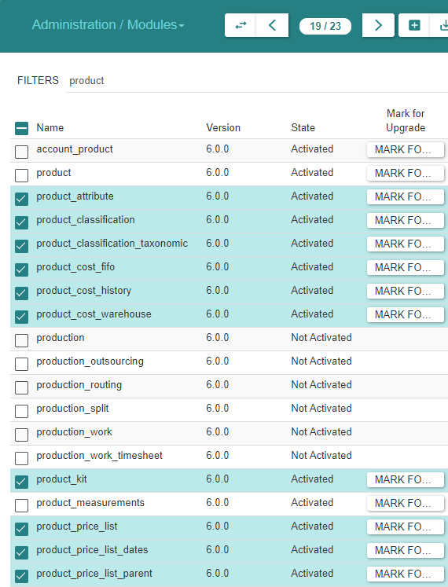
Module Activation

Slide 15
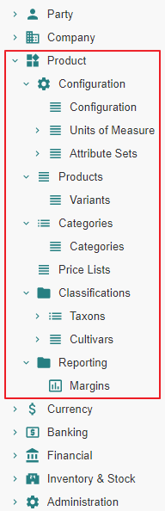
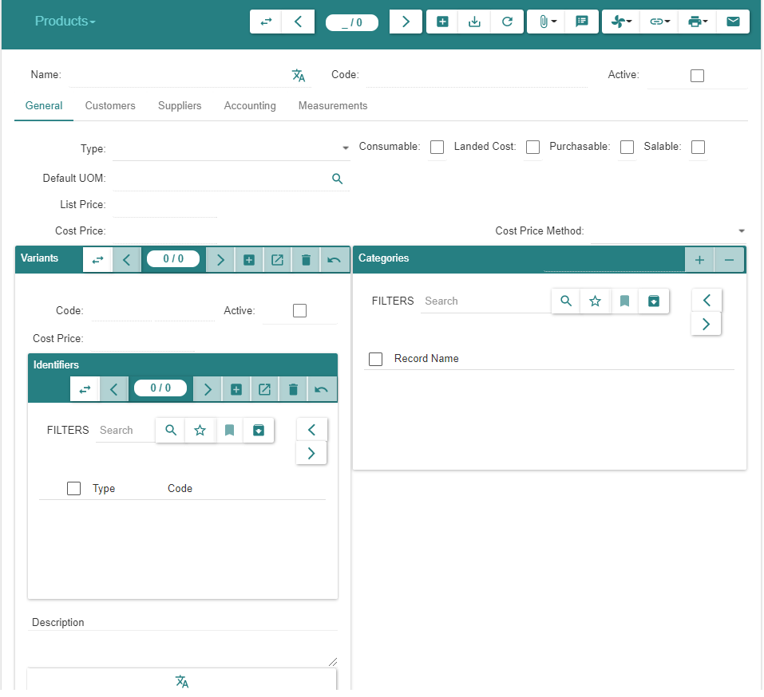
State « Post »

Slide 16
Product & Variant Creation

Slide 17
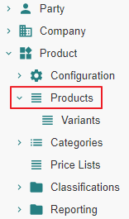
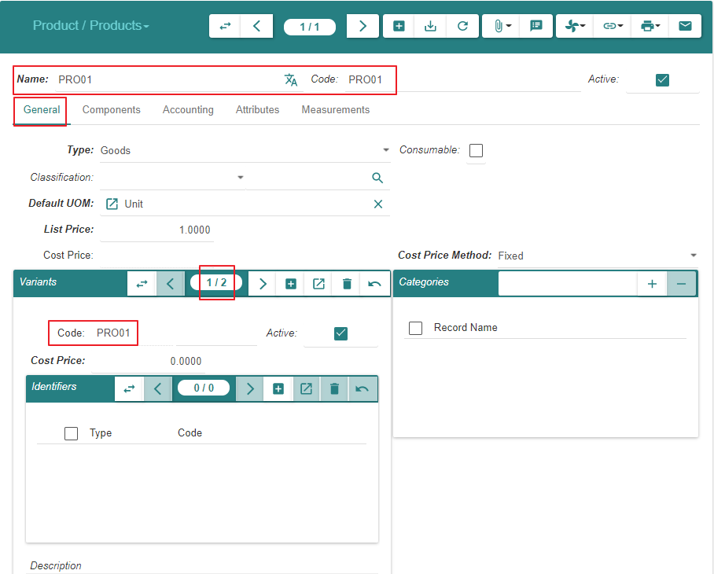
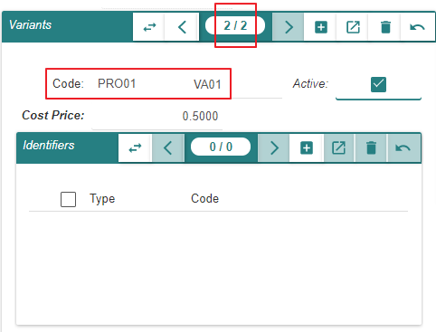
Create « Product PROD01 » & « Variant VA01 »

Slide 18
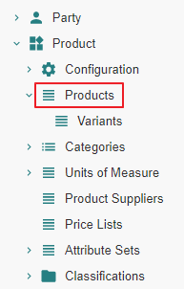
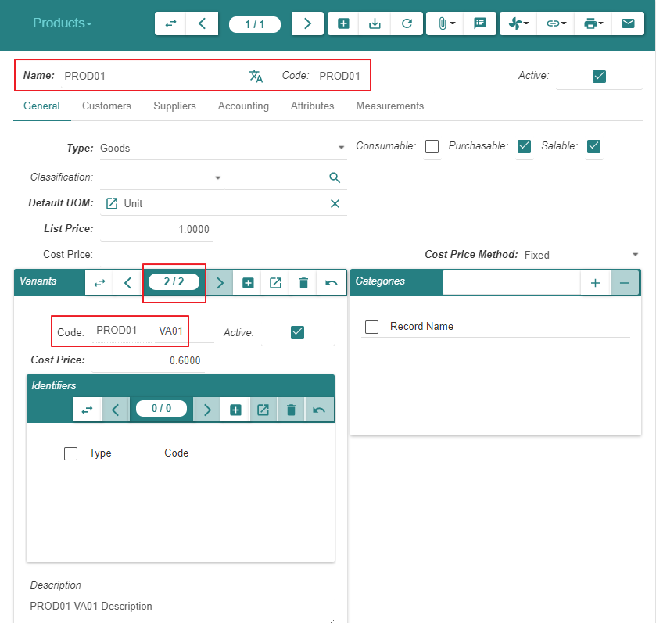
Create « Product PROD01 » & « Variant VA01 »

Slide 19
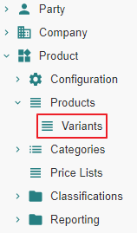
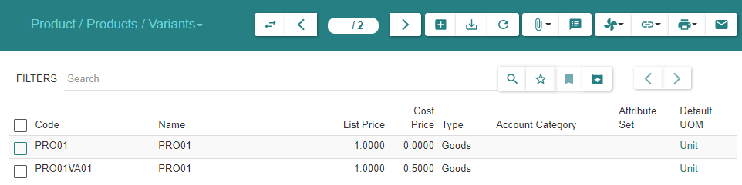
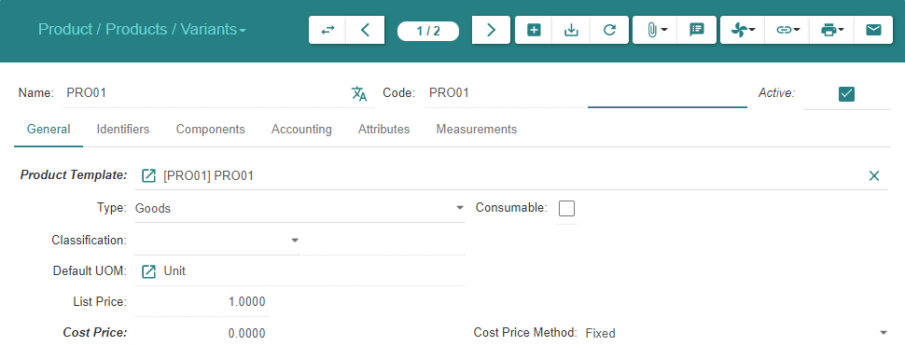
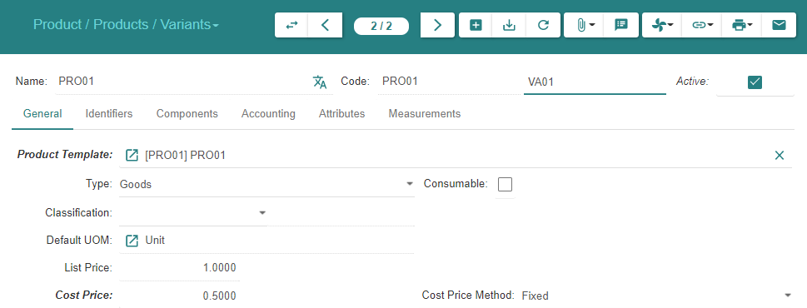
Display « Variants »

Slide 20
Inventory & Stock

Slide 21
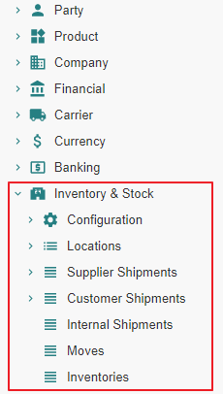
Motivation
We activate all inactive « Inventory & Stock » related modules

Slide 22
Module Activation

Slide 23
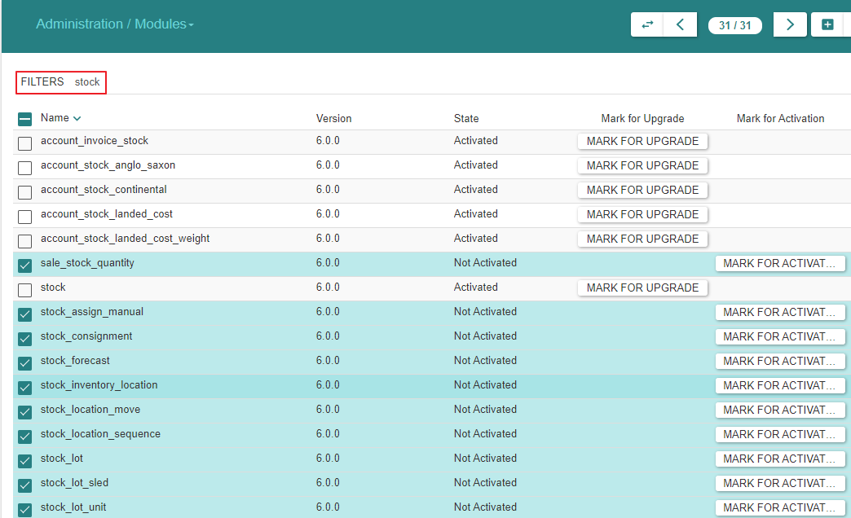
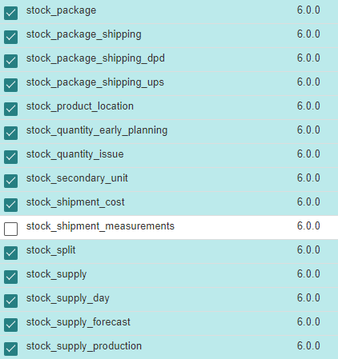
Module Activation

Slide 24
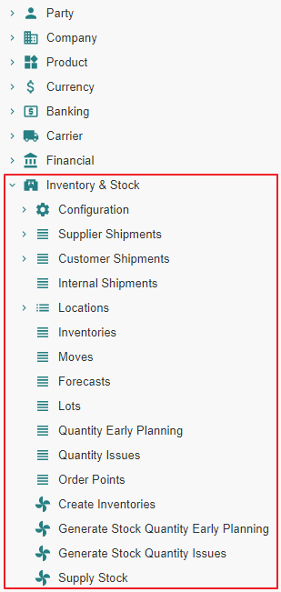
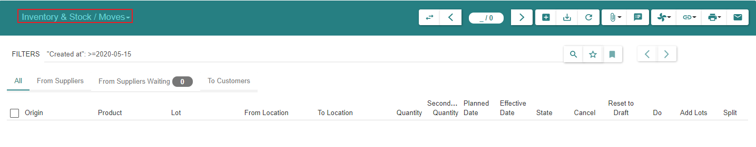
Menu Tree

Slide 25
Purchase

Slide 26
Module Activation

Slide 27
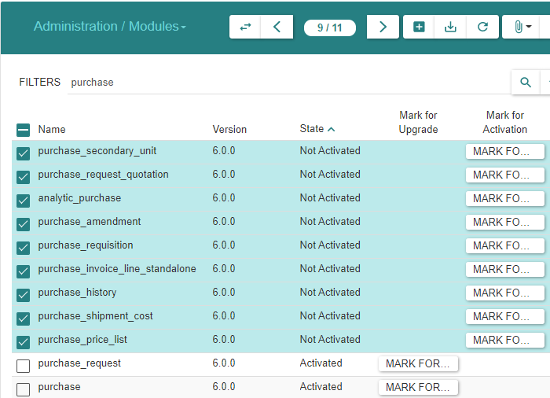
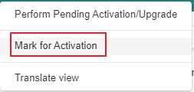
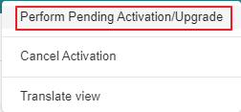
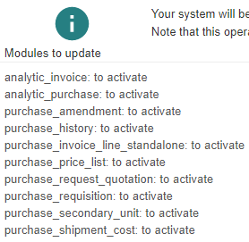
Module Activation

Slide 28
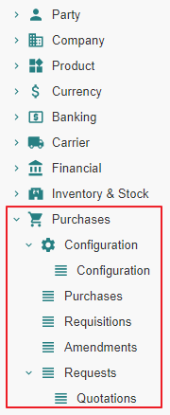
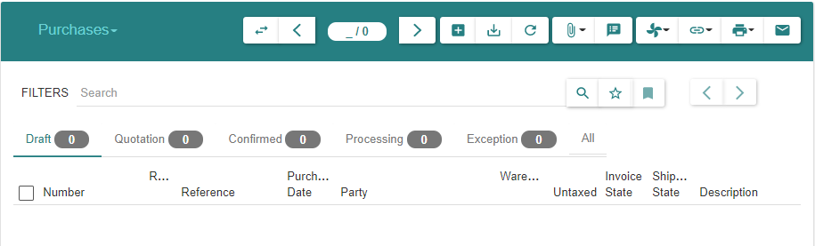
Menu Tree

Slide 29
Purchase Configuration

Slide 30
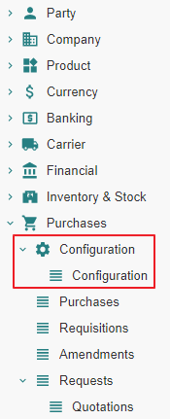
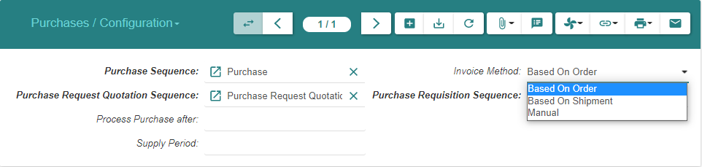
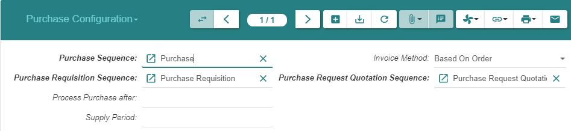
Purchase Configuration (1/2)
Note : The configuration for « Drop Shipment Sequence » will be available later once we activate the « Sale » modules

Slide 31
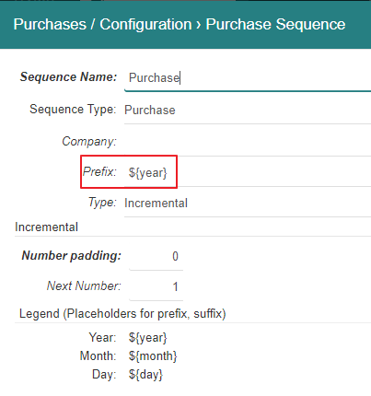
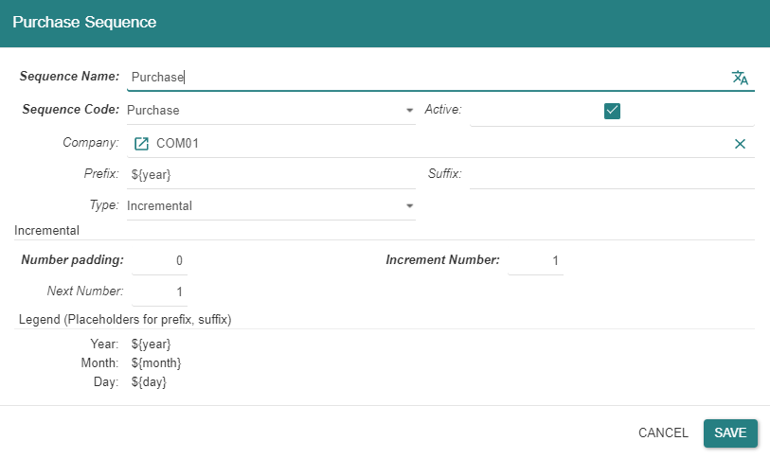
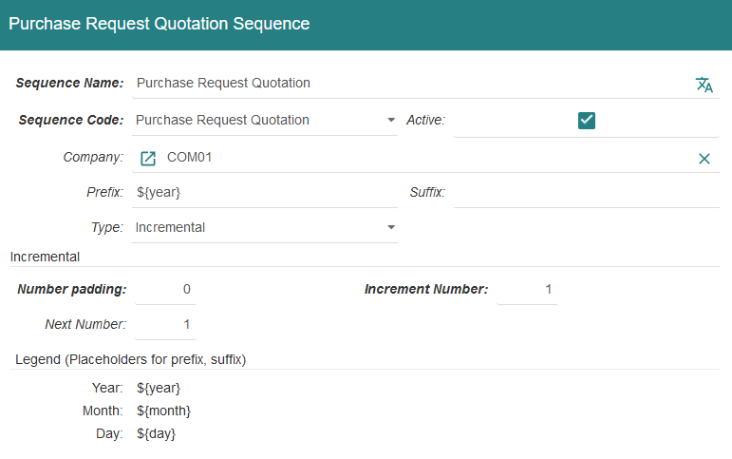
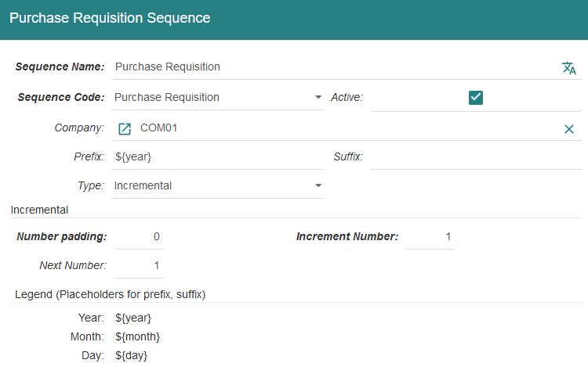
Purchase Configuration (2/2)

Slide 32
Product

Slide 33
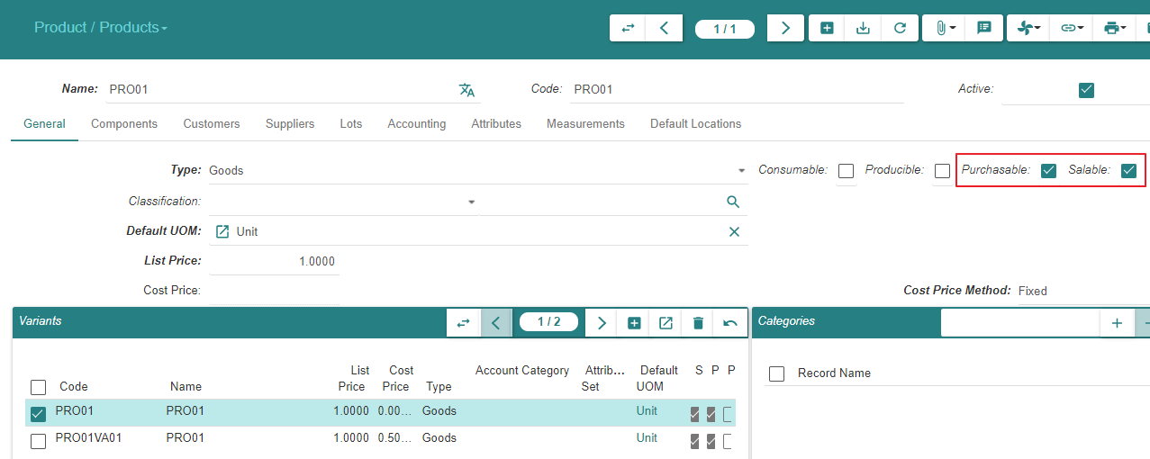
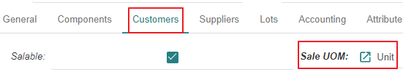
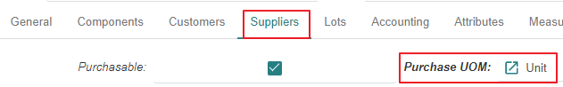
Motivation
We added the « Purchase » functionality to the system
We now declare the « Product » « Purchasable » & « Salable »

Slide 34
Purchase - State Changes - Impact Analysis Model

Slide 35
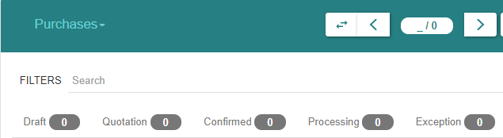
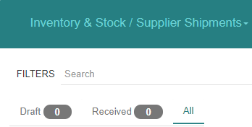
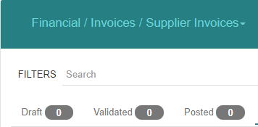
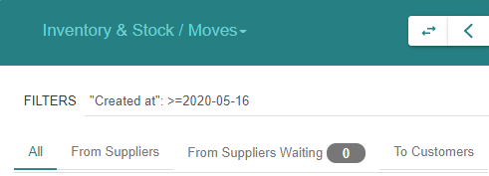
« Purchase » related states

Slide 36
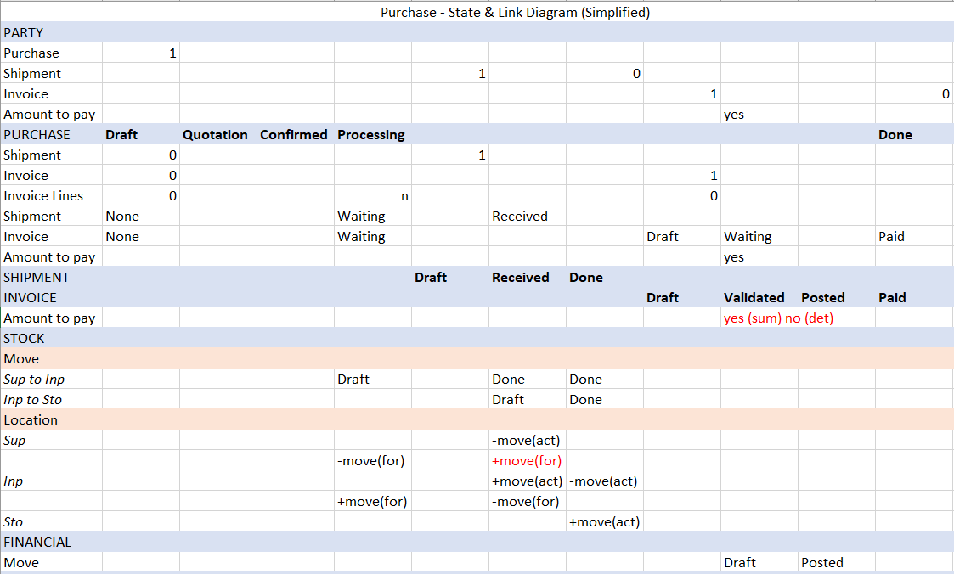
The basic State Diagram for « Purchases »

Slide 37
Impacted functions

Slide 38
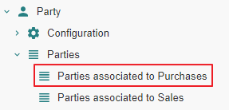
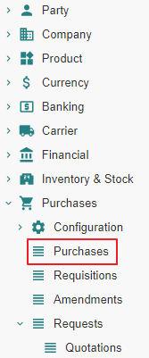
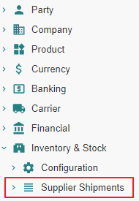

Impact analysis

Slide 39




Impact analysis

Slide 40




Impact analysis

Slide 41




Impact analysis

Slide 42
Supplier Purchase - State Changes - Impact Analysis

Slide 43
Purchase From State « Nill » to State « Draft »

Slide 44
Purchase From State « Nill » to State « Draft » Action

Slide 45




Purchase
Purchases are not numbered whilst they are in state « Draft »
Enter « Delivery Date » in order to track « Location Stock Forecast »

Slide 46
Purchase From State « Nill » to State « Draft » Impact

Slide 47
Purchase - From « Nill » To « Draft »
 |  | State | Created - Updated - Deleted -Linked
Supplier
Parties associated to Purchases | 1 |  | Linked to Purchase
Purchase
Purchases (Supplier) | 2 | Draft | Created
Shipment
Supplier Shipments (Supplier) | 3
Stock
Stock Locations | 4
Stock Moves | 5
Invoice
Invoices (Supplier) | 6
Invoice Lines | 7
Payment
Lines to Pay | 8
Payments | 9

Slide 48
Purchase - From « Nill » To « Draft »
 |  | State | Created - Updated - Deleted -Linked
Accounting
Journals - Periods | 10
Account Moves | 11
Open Journal | 12
General Ledger | 13
Balance Sheet | 14
Income Statement | 15
General Journal | 16

Slide 49



1 - Parties associated to Purchases

Slide 50


2 - Purchases | Purchases (SUP01)

Slide 51


10 - Journals - Periods

Slide 52

11 - Account Moves
An « Account Move Line » is created in « State-Draft ». It impacts the General Ledger, the Balance Sheet », the Income Statement, the (Specific, e.g. Expense) Journal, the General Journal.

Slide 53



12 - Open Journal
When an « Account Move Line » is created on a given « Journal » (e.g. « EXP »), it impacts the General Ledger, the Balance Sheet », the Income Statement, the (Specific, e.g. Expense) Journal, the General Journal.

Slide 54


13 - General Ledger

Slide 55


14 - Balance Sheet

Slide 56


15 - Income statement

Slide 57

16 - General Journal

Slide 58



16 - Statements

Slide 59
Purchase From State « Draft » to State « Quotation »

Slide 60
Purchase From State « Draft » to State « Quotation » Action

Slide 61



Purchase
Purchases are numbered when they reach state « Quotation »
Purchases can be returned to state « Draft », e.g. when the price has been renegociated with the « Supplier »

Slide 62
Purchase From State « Draft » to State « Quotation » Impact

Slide 63
Purchase - From « Draft » To « Quotation »
 |  | State | Created - Updated - Deleted -Linked
Supplier
Parties associated to Purchases | 1 |  | Linked to Purchase
Purchase
Purchases (Supplier) | 2 | Quotation | Updated
Shipment
Supplier Shipments (Supplier) | 3
Stock
Stock Locations | 4
Stock Moves | 5
Invoice
Invoices (Supplier) | 6
Invoice Lines | 7
Payment
Lines to Pay | 8
Payments | 9

Slide 64
Purchase - From « Draft » To « Quotation »
 |  | State | Created - Updated - Deleted -Linked
Accounting
Journals - Periods | 10
Account Moves | 11
Open Journal | 12
General Ledger | 13
Balance Sheet | 14
Income Statement | 15
General Journal | 16

Slide 65
1 - Parties associated to Purchases

Slide 66



2 - Purchases | Purchases (SUP01)

Slide 67
Purchase From State « Quotation » to State « Confirmed » or From State « Quotation » to State « Processing »

Slide 68

State transitions
Upon « Confirm » action by the user, a « Sale » or « Purchase » evolves from state « Quotation » to :
State « Confirmed » when a latent purchase processing error condition exists
State « Processing » when such error does not exist.
In the present scenario, the error condition consists in the « Product » not being linked to an « Account Category » and the state transition is from « Quotation » to « Confirmed »
Confirmed
Confirm
-
Purchase Processing related Error Condition Exists
Confirm
-
Purchase Processing related Error Condition Resolved
Confirm
-
Purchase Processing possible
Confirm
Quotation
Processing

Slide 69
Purchase From State « Quotation » to State «Confirmed »

Slide 70
Purchase From State « Quotation » to State «Confirmed » Action

Slide 71


Purchase

Slide 72
Purchase From State « Quotation » to State «Confirmed » Impact

Slide 73
Purchase - From « Quotation » To « Confirmed »
 |  | State | Created - Updated - Deleted -Linked
Supplier
Parties associated to Purchases | 1 |  | Linked to Purchase
Purchase
Purchases (Supplier) | 2 | Confirmed | Updated
Shipment
Supplier Shipments (Supplier) | 3
Stock
Stock Locations | 4
Stock Moves | 5
Invoice
Invoices (Supplier) | 6
Invoice Lines | 7
Payment
Lines to Pay | 8
Payments | 9

Slide 74
Purchase - From « Quotation » To « Confirmed »
 |  | State | Created - Updated - Deleted -Linked
Accounting
Journals - Periods | 10
Account Moves | 11
Open Journal | 12
General Ledger | 13
Balance Sheet | 14
Income Statement | 15
General Journal | 16

Slide 75


2 - Purchases | Purchases (SUP01)

Slide 76
Purchase From State « Confirmed » to State «Processing » Action

Slide 77


Purchase
The button “Process” checks that the purchase order is in a correct state with respect to forthcoming shipment, invoicing and accounting treatment.
In our example, an “Account Category” is missing on the “Product PROD01”

Slide 78


Purchase

Slide 79

Purchase

Slide 80
Purchase From State « Confirmed » to State «Processing » Impact

Slide 81
Purchase - From « Confirmed » To « Processing »
 |  | State | Created - Updated - Deleted -Linked
Supplier
Parties associated to Purchases | 1 |  | Linked to Purchase
Purchase
Purchases (Supplier) | 2 | Processing | Updated
Shipment
Supplier Shipments (Supplier) | 3
Stock
Stock Locations | 4 |  | Created (forecast) [Supplier -= Move ; Input Zone += Move]
Stock Moves | 5 | Draft | Created [Supplier to Input Zone]
Invoice
Invoices (Supplier) | 6
Invoice Lines | 7 |  | Created [Linked to Purchase Line]
Payment
Lines to Pay | 8
Payments | 9

Slide 82
Purchase - From « Confirmed » To « Processing »
 |  | State | Created - Updated - Deleted -Linked
Accounting
Journals - Periods | 10
Account Moves | 11
Open Journal | 12
General Ledger | 13
Balance Sheet | 14
Income Statement | 15
General Journal | 16

Slide 83


2 - Purchases | Purchases (SUP01)

Slide 84



4 - Stock Locations

Slide 85



4 - Stock Locations

Slide 86



5 - Stock Moves
« From Suppliers Waiting » iff « Purchase Delivery Date » exists

Slide 87



7 - Invoice Lines

Slide 88
Supplier Shipment - State Changes - Actual States

Slide 89

Motivation
It is certainly possible to process the shipment(s) pertaining to a « Purchase » using the « Move » menu item.
However, it is recommended to proceed using the « Supplier Shipment » functionality which will manage the following stock moves in a coherent fashion :
« Incoming Moves » between the supplier location and the warehouse input location
« Storage Moves » between the warehouse input location and the warehouse storage location

Slide 90
Supplier Shipment « Nill » To « Draft »

Slide 91
Supplier Shipment From « Nill » To « Draft » Action

Slide 92

Supplier Shipments – Incoming Moves - Using « Added » or « Created »

Slide 93

Supplier Shipments – Incoming Moves - Using « Added »

Slide 94

Supplier Shipments – Incoming Moves - Using « Created » (1/2)

Slide 95


Supplier Shipments – Incoming Moves - Using « Created » (2/2)
Using « Created », it is possible to fine tune « Product », « Quantity », « Unit Price »

Slide 96

Supplier Shipments – Inventory Moves

Slide 97
Supplier Shipment From « Nill » To « Draft » Impact

Slide 98
Supplier Shipment - From « Nill » To « Draft »
 |  | State | Created - Updated - Deleted -Linked
Supplier
Parties associated to Purchases | 1 |  | Linked to Purchase ; Linked to Shipment
Purchase
Purchases (Supplier) | 2 | Processing | Updated ; Linked to Shipment
Shipment
Supplier Shipments (Supplier) | 3 | Draft | Created
Stock
Stock Locations | 4 |  | Created (forecast) [Supplier -= Move ; Input Zone += Move]
Stock Moves | 5 | Draft | Created [Supplier to Input Zone]
Invoice
Invoices (Supplier) | 6
Invoice Lines | 7 |  | Created [Linked to Purchase Line]
Payment
Lines to Pay | 8
Payments | 9

Slide 99
Supplier Shipment - From « Nill » To « Draft »
 |  | State | Created - Updated - Deleted -Linked
Accounting
Journals - Periods | 10
Account Moves | 11
Open Journal | 12
General Ledger | 13
Balance Sheet | 14
Income Statement | 15
General Journal | 16

Slide 100

1 Parties associated to Purchases

Slide 101


2 - Purchases | Purchases (SUP01)

Slide 102



3 - Supplier Shipments | Supplier Shipments (SUP01)

Slide 103
Supplier Shipment « Draft » To « Received »

Slide 104
Supplier Shipment From « Draft » To « Received » Action

Slide 105


Supplier Shipments - Incoming Moves

Slide 106

Supplier Shipments - Inventory Moves

Slide 107
Supplier Shipment From « Draft » To « Received » Impact

Slide 108
Supplier Shipment - From « Draft » To « Received »
 |  | State | Created - Updated - Deleted -Linked
Supplier
Parties associated to Purchases | 1 |  | Linked to Purchase ; Linked to Shipment
Purchase
Purchases (Supplier) | 2 | Processing | Updated ; Linked to Shipment
Shipment
Supplier Shipments (Supplier) | 3 | Received | Updated
Stock
Stock Locations | 4 |  | Created (actual) [Supplier -= Move ; Input Zone += Move]
Stock Moves | 5 | Done [Supplier to Input] ; Draft [Input to Storage] | Updated [Supplier to Input] ; Created [Input to Storage]
Invoice
Invoices (Supplier) | 6
Invoice Lines | 7 |  | Created [Linked to Purchase Line]
Payment
Lines to Pay | 8
Payments | 9

Slide 109
Supplier Shipment - From « Draft » To « Received »
 |  | State | Created - Updated - Deleted -Linked
Accounting
Journals - Periods | 10
Account Moves | 11
Open Journal | 12
General Ledger | 13
Balance Sheet | 14
Income Statement | 15
General Journal | 16

Slide 110


2 - Purchases | Purchases (SUP01)

Slide 111

3 - Supplier Shipments | Supplier Shipments (SUP01)

Slide 112

4 - Stock Locations
« Supplier Forecast Quantity » remains « -5 », should be « 0 »

Slide 113

4 - Stock Locations

Slide 114


5 - Stock Moves

Slide 115
Supplier Shipment From « Received » to « Done »

Slide 116
Supplier Shipment From « Received » To « Done » Action

Slide 117

Supplier Shipments

Slide 118


Supplier Shipments

Slide 119

Supplier Shipments

Slide 120
Supplier Shipment From « Received » To « Done » Impact

Slide 121
Supplier Shipment - From « Received » To « Done »
 |  | State | Created - Updated - Deleted -Linked
Supplier
Parties associated to Purchases | 1 | Updated | Linked to Purchase
Purchase
Purchases (Supplier) | 2 | Processing | Updated ; Linked to Shipment
Shipment
Supplier Shipments (Supplier) | 3 | Done | Updated
Stock
Stock Locations | 4 |  | Updated [Input -= Move ; Storage += Move]
Stock Moves | 5 | Done [Input to Storage] | Updated [Input to Storage]
Invoice
Invoices (Supplier) | 6
Invoice Lines | 7 |  | Created [Linked to Purchase Line]
Payment
Lines to Pay | 8
Payments | 9

Slide 122
Supplier Shipment - From « Received » To « Done »
 |  | State | Created - Updated - Deleted -Linked
Accounting
Journals - Periods | 10
Account Moves | 11
Open Journal | 12
General Ledger | 13
Balance Sheet | 14
Income Statement | 15
General Journal | 16

Slide 123


1 - Parties associated to Purchases

Slide 124



2 - Purchases | Purchases (SUP01)
Note : The « Shipment » information appears to be different depending on the linked-by entity :
From the viewpoint « Supplier », there is no « Shipment » linked-to anymore
From the viewpoint « Purchase » there is still a « Shipment » linked-to

Slide 125



3 - Supplier Shipments | Supplier Shipments (SUP01)

Slide 126

4 - Stock Locations

Slide 127

4 - Stock Locations

Slide 128


4 - Stock Locations

Slide 129

5 - Stock Moves

Slide 130
Supplier Invoice - State Changes - Actual States

Slide 131
Supplier Invoices From State « Nill » to State « Draft »

Slide 132
Supplier Invoices From State « Nill » to State « Draft » Action

Slide 133


Supplier Invoices (1/3)

Slide 134

Supplier Invoices (2/3)

Slide 135

Supplier Invoices (3/3)

Slide 136



Supplier Invoice Lines
« Supplier Invoice Lines » are referenced to help build the « Supplier Invoice »

Slide 137
Supplier Invoices From State « Nill » to State « Draft » Impact

Slide 138
Supplier Invoices - From « Nill » To « Draft »
 |  | State | Created - Updated - Deleted -Linked
Supplier
Parties associated to Purchases | 1 | Updated | Linked to Purchase
Purchase
Purchases (Supplier) | 2 | Processing | Updated ; Linked to Shipment ; Linked to Invoice
Shipment
Supplier Shipments (Supplier) | 3 | Done | Updated
Stock
Stock Locations | 4 |  | Updated [Input -= Move ; Storage += Move]
Stock Moves | 5 | Done [Input to Storage] | Updated [Input to Storage]
Invoice
Invoices (Supplier) | 6 | Draft | Created ; Linked to Invoice Line
Invoice Lines | 7 |  | Linked to Invoice [Linked to Purchase Line]
Payment
Lines to Pay | 8
Payments | 9

Slide 139
Supplier Invoices - From « Nill » To « Draft »
 |  | State | Created - Updated - Deleted -Linked
Accounting
Journals - Periods | 10
Account Moves | 11
Open Journal | 12
General Ledger | 13
Balance Sheet | 14
Income Statement | 15
General Journal | 16

Slide 140


1 - Parties associated to Purchases

Slide 141


2 - Purchases | Purchases (SUP01)

Slide 142
Supplier Invoices

Slide 143
Supplier Invoice Lines
« Supplier Invoice Lines » are referenced to help build the « Supplier Invoice »

Slide 144
Supplier Invoices From State « Draft » to State « Validated »

Slide 145
Supplier Invoices From State « Draft » to State « Validated » Action

Slide 146


Supplier Invoices (1/2)

Slide 147

Supplier Invoices (2/2)

Slide 148
Supplier Invoices From State « Draft » to State « Validated » Impact

Slide 149
Supplier Invoices - From « Draft » To « Validated »
 |  | State | Created - Updated - Deleted -Linked
Supplier
Parties associated to Purchases | 1 | Updated | Linked to Purchase ; Updated [Payable = -6]
Purchase
Purchases (Supplier) | 2 | Processing | Updated ; Linked to Shipment ; Linked to Invoice
Shipment
Supplier Shipments (Supplier) | 3 | Done | Updated
Stock
Stock Locations | 4 |  | Updated [Input -= Move ; Storage += Move]
Stock Moves | 5 | Done [Input to Storage] | Updated [Input to Storage]
Invoice
Invoices (Supplier) | 6 | Validated | Created ; Linked to Invoice Line ; Linked to Lines to pay ; Payable amount set
Invoice Lines | 7 |  | Linked to Invoice [Linked to Purchase Line]
Payment
Lines to Pay | 8 |  | Not Visible whereas visible as part of Invoice and Accounting Journal (?)
Payments | 9

Slide 150
Supplier Invoices - From « Draft » To « Validated »
 |  | State | Created - Updated - Deleted -Linked
Accounting
Journals - Periods | 10 | Draft [Account Move Lines] | Created [Account Move Lines : 6011 - 4011]
Account Moves | 11 | Draft [Account Move Lines] | Created [Account Move Lines : 6011 - 4011]
Open Journal | 12 | Draft [Account Move Lines] | Created [Account Move Lines : 6011 - 4011] ; Journal « Expense » for Period 1st Quarter
General Ledger | 13 |  | Updated [Accounts 6011 & 4011]
Balance Sheet | 14 |  | Updated [Accounts 6011 & 4011]
Income Statement | 15 |  | Updated [Accounts 6011]
General Journal | 16 | Draft [Account Move Lines] | Created [Account Move Lines : 6011 - 4011]

Slide 151


1 - Parties associated to Purchases

Slide 152


2 - Purchases | Purchases (SUP01)

Slide 153


6 - Invoices | Invoices (SUP01) (1/2)

Slide 154

6 - Invoices | Invoices (SUP01) (2/2)

Slide 155

7 - Invoice Lines

Slide 156


8 - Lines to Pay

Slide 157



10 - Journals - Periods

Slide 158

10 - Journals - Periods

Slide 159


11 - Account Moves

Slide 160


12 - Open Journal

Slide 161


13 - General Ledger

Slide 162

14 - Balance Sheet

Slide 163

14 - Balance Sheet

Slide 164

15 - Income statement

Slide 165


16 - General Journal

Slide 166
Supplier Invoices From State « Validated » to State « Posted »

Slide 167

Motivation

Slide 168
Supplier Invoices From State « Validated » to State « Posted » Action

Slide 169

Supplier Invoices (1/2)
Notice that the « Post » operation could have been performed on the « Account Move » screen

Slide 170

Supplier Invoices (2/2)

Slide 171
Supplier Invoices From State « Validated » to State « Posted » Impact

Slide 172
Supplier Invoices - From « Validated » To « Posted »
 |  | State | Created - Updated - Deleted -Linked
Supplier
Parties associated to Purchases | 1 | Updated | Linked to Purchase
Purchase
Purchases (Supplier) | 2 | Processing | Updated ; Linked to Shipment ; Linked to Invoice
Shipment
Supplier Shipments (Supplier) | 3 | Done | Updated
Stock
Stock Locations | 4 |  | Updated [Input -= Move ; Storage += Move]
Stock Moves | 5 | Done [Input to Storage] | Updated [Input to Storage]
Invoice
Invoices (Supplier) | 6 | Posted | Created ; Linked to Invoice Line ; Linked to Lines to pay ; Payable amount set
Invoice Lines | 7 |  | Linked to Invoice [Linked to Purchase Line]
Payment
Lines to Pay | 8 |  | Not Visible whereas visible as part of Invoice and Accounting Journal (?)
Payments | 9

Slide 173
Supplier Invoices - From « Validated » To « Posted »
 |  | State | Created - Updated - Deleted -Linked
Accounting
Journals - Periods | 10 | Posted [Account Move Lines] | Created [Account Move Lines : 6011 - 4011]
Account Moves | 11 | Posted [Account Move Lines] | Created [Account Move Lines : 6011 - 4011]
Open Journal | 12 | Posted [Account Move Lines] | Created [Account Move Lines : 6011 - 4011] ; Journal « Expense » for Q1
General Ledger | 13 |  | Updated [Accounts 6011 & 4011]
Balance Sheet | 14 |  | Updated [Accounts 4011]
Income Statement | 15 |  | Updated [Accounts 6011]
General Journal | 16 | Draft [Account Move Lines] | Created [Account Move Lines : 6011 - 4011]

Slide 174


2 - Purchases | Purchases (SUP01)

Slide 175
6 - Invoices | Invoices (SUP01) (1/2)
Notice that the « Post » operation could have been performed on the « Account Move » screen

Slide 176
6 - Invoices | Invoices (SUP01) (2/2)

Slide 177


8 - Lines to Pay

Slide 178


10 - Journals - Periods

Slide 179


11 - Account Moves

Slide 180


12 - Open Journal

Slide 181
Supplier Payment - State Changes - Actual States

Slide 182
Payment

Slide 183
Payment Precondition

Slide 184




Invoice Payment Method

Slide 185
Payment Action

Slide 186



Supplier Invoice (1/2)

Slide 187

Supplier Invoice (2/2)

Slide 188
Payment Impact

Slide 189
Payment
 |  | State | Created - Updated - Deleted -Linked
Supplier
Parties associated to Purchases | 1 | Updated | Linked to Purchase ; Updated [Payable = 0]
Purchase
Purchases (Supplier) | 2 | Processing | Updated ; Linked to Shipment ; Linked to Invoice
Shipment
Supplier Shipments (Supplier) | 3 | Done | Updated
Stock
Stock Locations | 4 |  | Updated [Input -= Move ; Storage += Move]
Stock Moves | 5 | Done [Input to Storage] | Updated [Input to Storage]
Invoice
Invoices (Supplier) | 6 | Paid | Created ; Linked to Invoice Line ; Linked to Lines to pay ; Payable amount set
Invoice Lines | 7 |  | Linked to Invoice [Linked to Purchase Line]
Payment
Lines to Pay | 8
Payments | 9

Slide 190
Payment
 |  | State | Created - Updated - Deleted -Linked
Accounting
Journals - Periods | 10 | Posted [Account Move Lines] | Created [Account Move Lines : 6011 - 4011] ; [Account Move Lines : 5311 - 4011]
Account Moves | 11 | Posted [Account Move Lines] | Created [Account Move Lines : 6011 - 4011] ; [Account Move Lines : 5311 - 4011]
Open Journal | 12 | Posted [Account Move Lines] | Created [Account Move Lines : 6011 - 4011] ; Journal « Expense » for Q1 Created [Account Move Lines : 5311 - 4011] ; Journal « Cash » for Q1
General Ledger | 13 |  | Updated [Accounts 6011 & 4011] ; Created [Move Lines : 5311 - 4011]
Balance Sheet | 14 |  | Updated [Accounts 4011] ; [Account Move Lines : 5311 - 4011]
Income Statement | 15 |  | Updated [Accounts 6011]
General Journal | 16 | Posted [Account Move Lines] | Created [Account Move Lines : 6011 - 4011] ; [Account Move Lines : 5311 - 4011]

Slide 191



1 - Parties associated to Purchases

Slide 192


2 - Purchases | Purchases (SUP01)

Slide 193
6 - Invoices | Invoices (SUP01) (1/2)

Slide 194
6 - Invoices | Invoices (SUP01) (2/2)

Slide 195
8 - Lines to Pay

Slide 196

9 - Payments
Notice that there are no « Payments » registered

Slide 197



10 - Journals - Periods

Slide 198


11 - Account Moves

Slide 199

11 - Account Moves

Slide 200


12 - Open Journal

Slide 201


12 - Open Journal

Slide 202

13 - General Ledger

Slide 203

14 - Balance Sheet

Slide 204

14 - Balance Sheet

Slide 205

16 - General Journal

